Slide 1
20190325
Machine Learning를 이용한 1D DBR 설계
Deep Q Network (DQN)
Lee Jong Geon

Slide 2
Artificial Intelligence
Machine Learning
Supervised
Learning
Unsupervised Learning
Reinforcement
Learning
Classification
Clustering, recommendation
Reward maximization

Slide 3



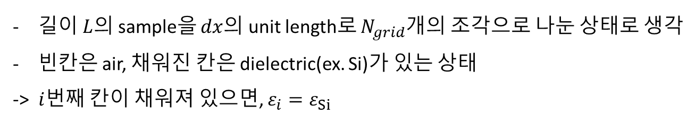
1D DBR model
$$L=N_{grid}∗dx$$
$$dx$$
$$i$$
…
길이 $L$의 sample을 $dx$의 unit length로 $N_{grid}$개의 조각으로 나눈 상태로 생각
빈칸은 air, 채워진 칸은 dielectric(ex. Si)가 있는 상태
-> $i$번째 칸이 채워져 있으면, $ε_{i}=ε_{Si}$

Slide 4
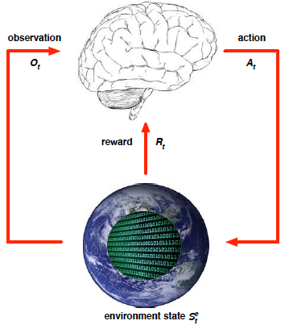
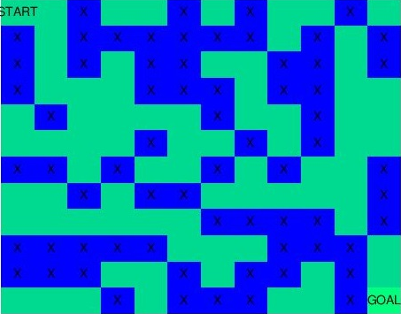
Q Learning
State(s), action(a), reward, state transition probability
Q: action-value function
$$Q\left(s_{t},a_{t}\right) ←Q\left(s_{t},a_{t}\right)+α\left[r_{t+1 }+γ\max_{a}{Q\left(s_{t+1},a\right)}−Q\left(s_{t},a_{t}\right)\right]$$
The New Action Value = The Old Value + The Learning Rate*(The New Information – The Old Information)
Ex. Maze Q-table
Q(s,a)
State = 12 * 12, action = 4 (up, down, right, left)
Q-table: 12*12*4
State가 table로 정의하기 힘들 정도로 많아지면 문제

Slide 5
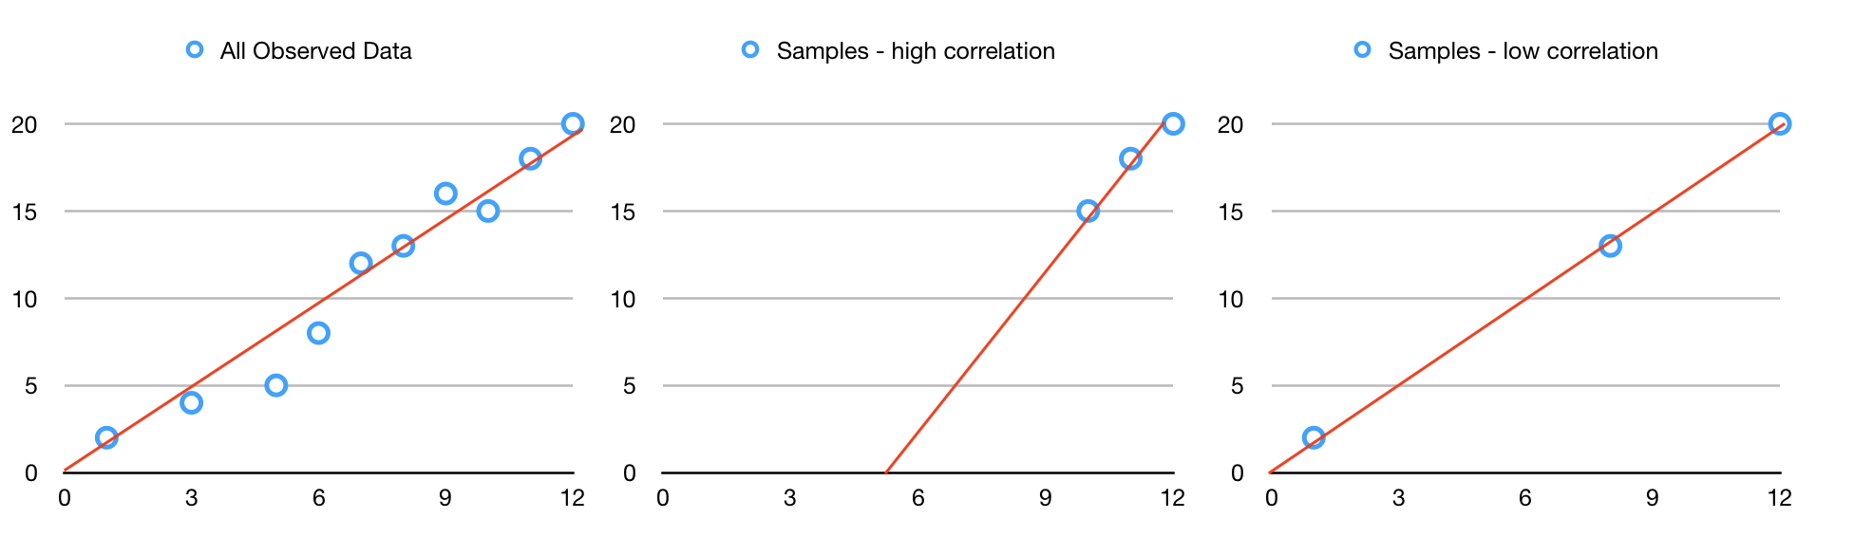
Q Network의 문제점
1. Correlation between samples
2. Non-stationary targets
$$L_{i}\left(θ_{i}\right)=Ε\left[{\left(r+γ\max{Q\left(s^{′},a^{′};θ_{i}\right)}−Q\left(s,a;θ_{i}\right)\right)}^{2}\right]$$
target
learn

Slide 6
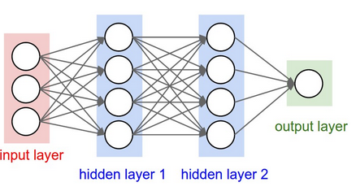
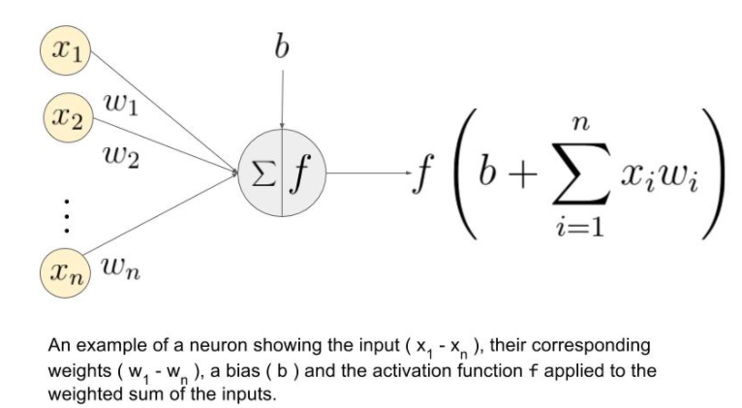
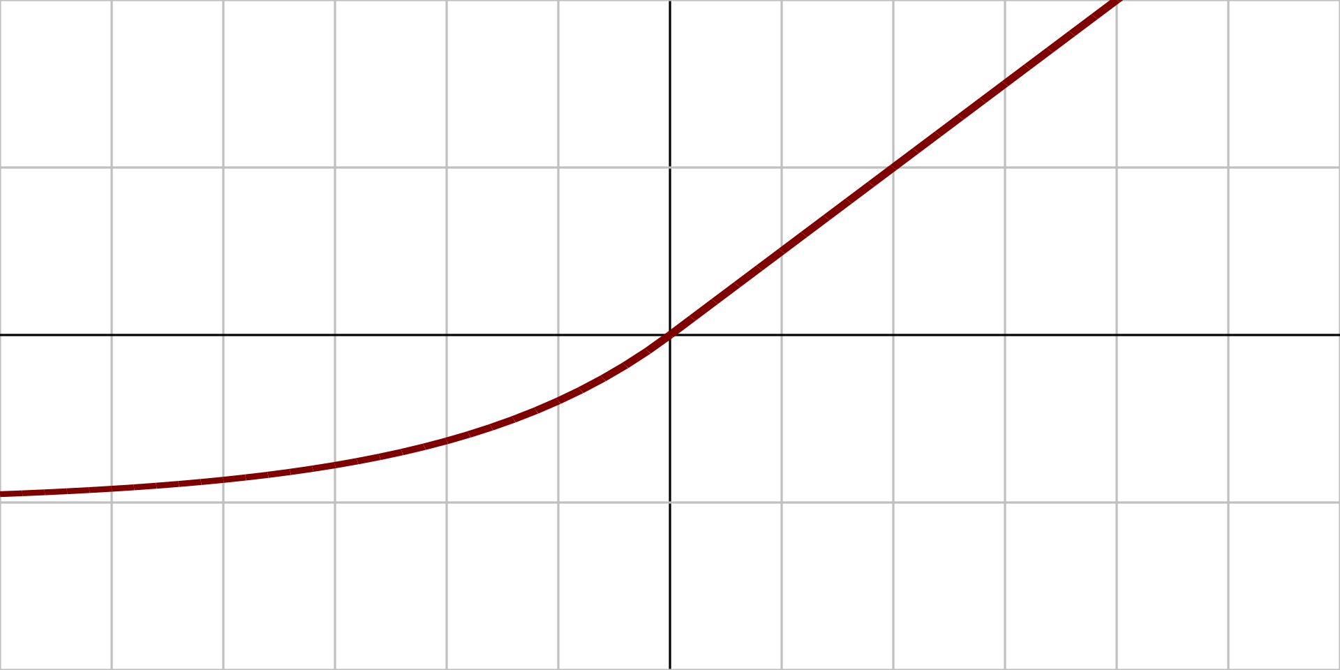



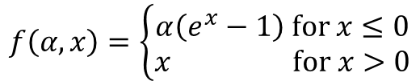


Deep Q Network (DQN)
Q(s,a)
$$N_{grid}$$
$$N_{grid}$$
$$N_{grid}$$
1) $N_{grid}$
2) ${2N}_{grid}$
$$f\left(α,x\right)=\left\{\begin{aligned}α\left(e^{x}−1\right) for x≤0 \\ x for x>0\end{aligned}\right.$$
Input: pixel 의 상태 (0 or 1)
Output: 다음 pixel의 상태 1)Opposite 2)0 or 1
Hidden layer: fully connected network, activation func. = ELU

Slide 7
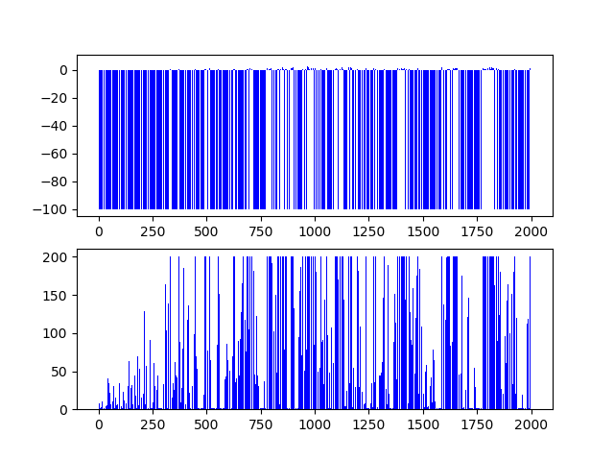
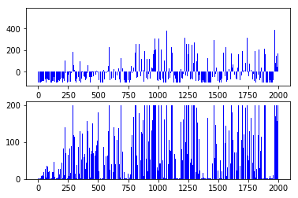


Deep Q Network (DQN)
CPU: 3 hours
GPU: 2 hours
Reward
Max Step
$$r_{i}=Q_{i}−Q_{i−1}$$
$$r_{i}=Q_{i}$$
Fail Q factor = -1000 -> reward = -100
Reward Scale Problem: 학습해야하는 Q-value의 variance가 매우 커서 학습이 어려움
Fail Q factor = -10 (reward = -1)으로 조정

Slide 8
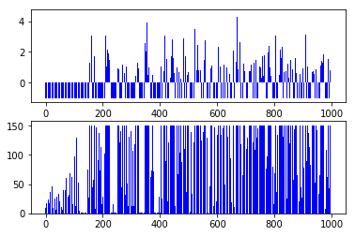
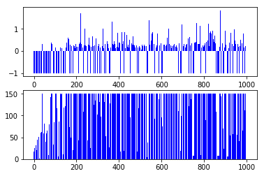
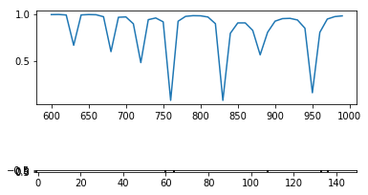

Deep Q Network (DQN)
$$r_{i}=Q_{i}−Q_{i−1}$$
Scale 조정 (1/3)
Reward
Max Step
Fail 조건에 도달하는 경우는 적어지지만, reward가 증가하는 형태가 아님

Slide 9
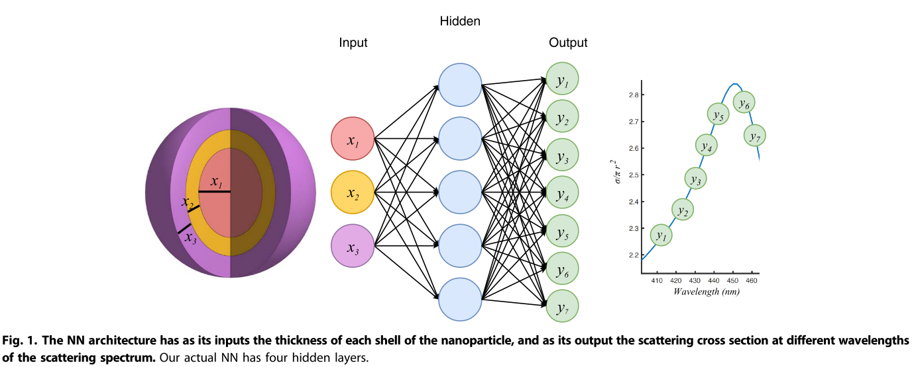
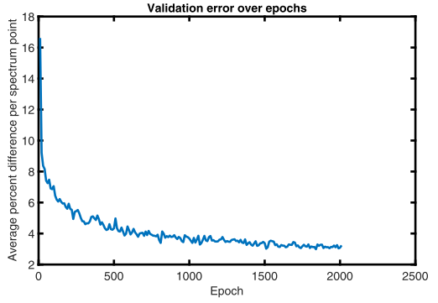
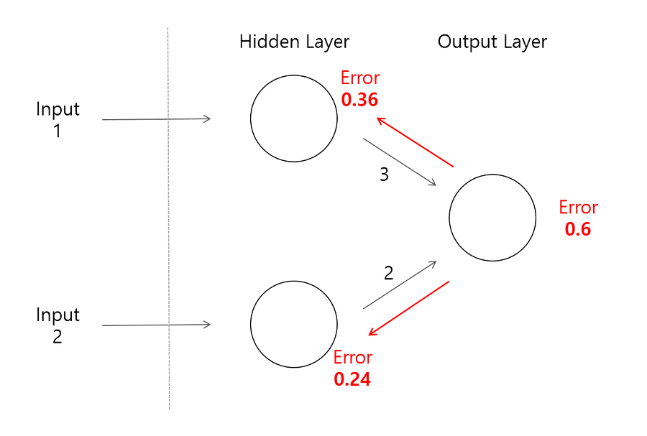
Deep Q Network (DQN)
2018-Science Advance-Nanophotonic particle simulation and inverse design using artificial neural networks
(John Peurifoy, Yichen Shen, Li Jing, Yi Yang, Fidel Cano-Renteria, Brendan G. DeLacy, John D. Joannopoulos, Max Tegmark, Marin Solijacic)
Input: thickness of nanomaterial shell
Output: spectrum point
4 hidden layers, 250 neurons per layer
Hidden layer와 neurons per layer 증가
* Layer 개수가 너무 많으면 error backpropagation이 잘 일어나지 않아 학습이 어려움

Slide 10
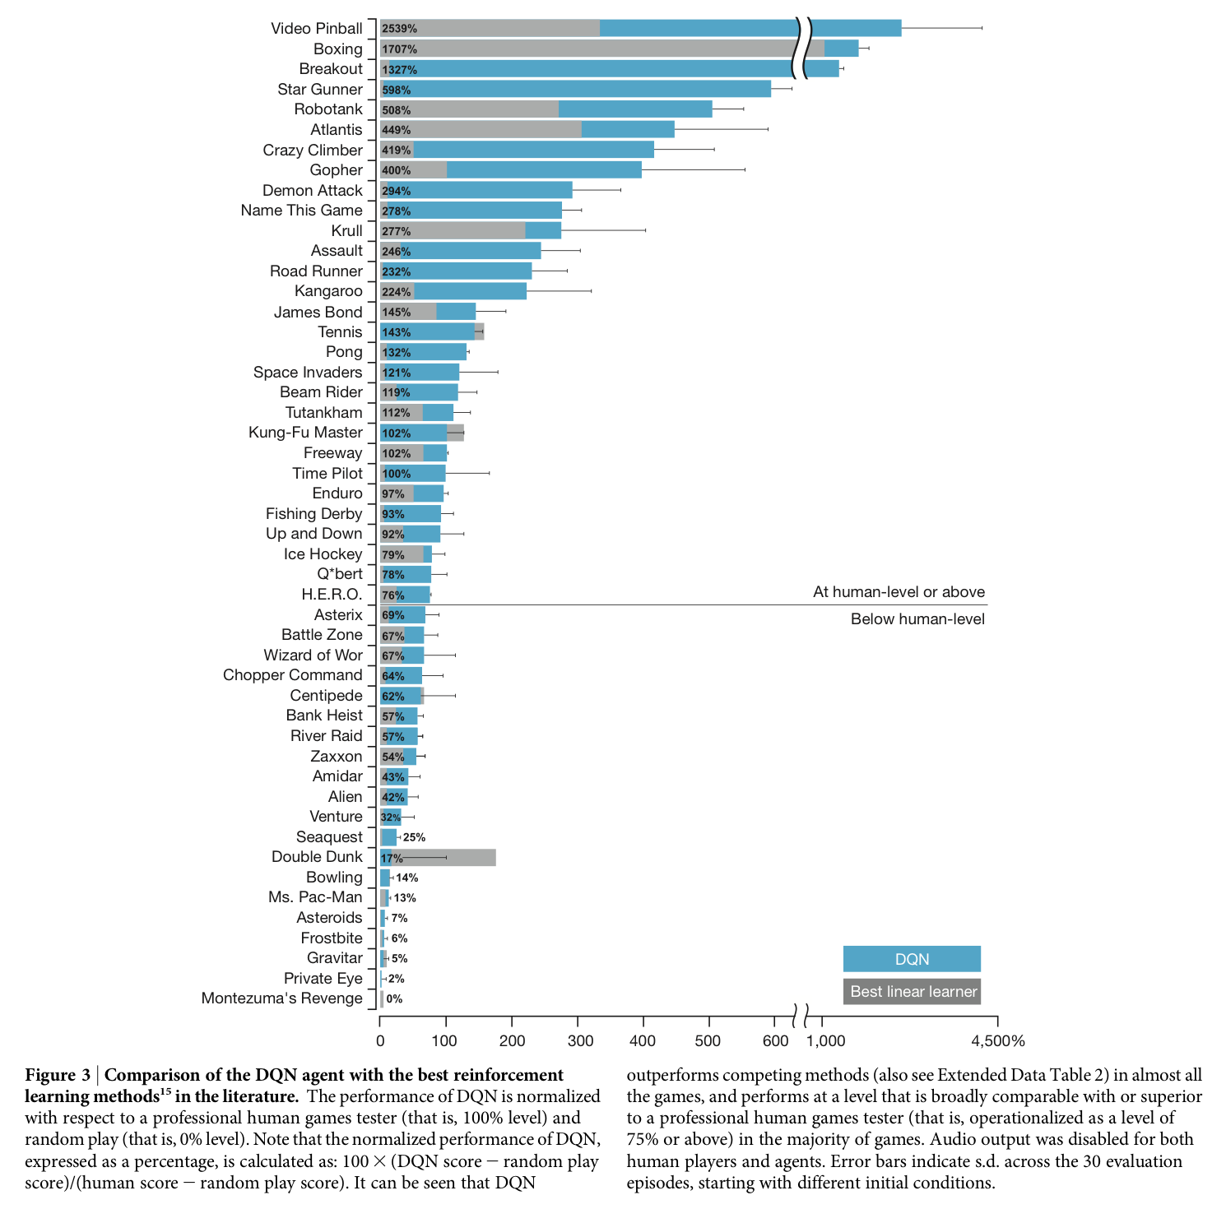
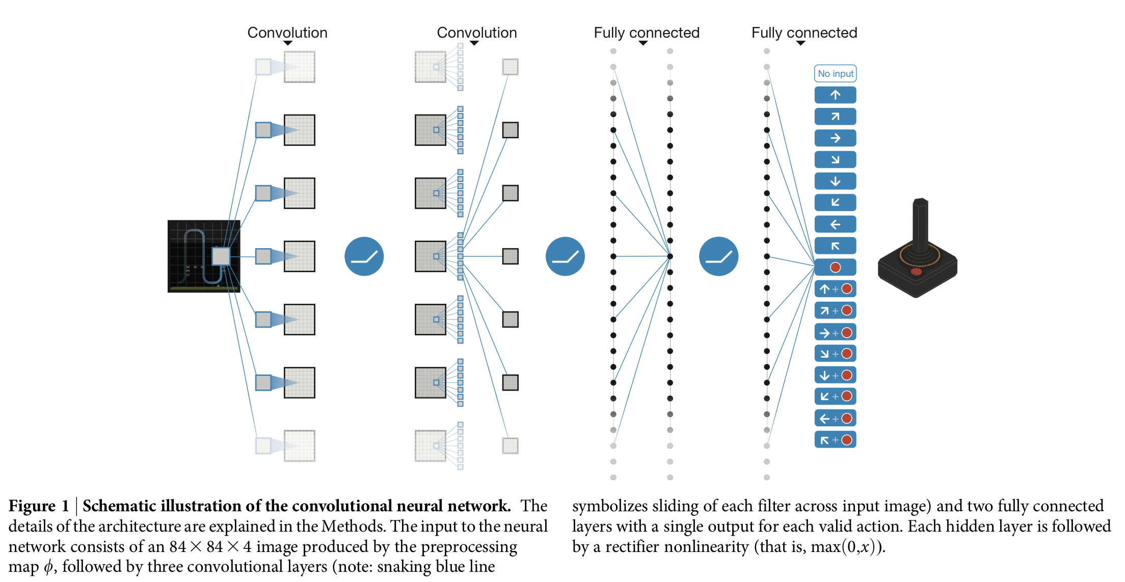
This Week
Hidden layer, neurons per layer 개수 조정
학습된 neural network 저장하고 불러와서 사용하는 기능 구현
DQN에서 향상된 알고리즘 조사

